Slide 1
Improving Hospital Observation Montanaro Observation Unit
Harshan Ragavandar Ramesh
Quang Nhut Ly
Siddhanth Polepally

Slide 2
Table of contents
01.
02.
Introduction
Data
03.
04.
EDA
Model
05.
Conclusion

Slide 3
Introduction
Objective: Improve OU efficiency at Montanaro Hospital.
Issue: Frequent patient transfers from observation to inpatient.
Approach: Predictive analytics.
Data: EHR records – demographics, diagnoses, medications, vital signs.
Outcome: Better bed management, reduced ED overcrowding, improved patient flow and revenue.

Slide 4
DATA
The dataset contains patient records from the Observation Unit (OU) at Montanaro Hospital. It includes key patient attributes such as vital signs, demographics, and hospital stay details. The data is essential for predicting patient transfers from observation to inpatient status. This dataset serves as the foundation for analysis and model development.
CATEGORICAL GROUPING
The dataset contains both quantitative and qualitative variables.
Quantitative variables such as temperature, pulse, and respiration rates were used directly in the analysis. Qualitative variables like gender and insurance categories were converted into factors for predictive modeling, with dummy variables created where needed.
The "Flipped" variable, indicating patient transfer status, was recoded into categorical format. Feature engineering included transforming and grouping these variables to improve model performance.

Slide 5

DATA DICTIONARY
Column Names | Variable Definition
Age | Age of patient, in years
Gender | Patient gender (recorded as Male/Female)
PrimaryInsuranceCategory | Insurance provider for the patient
Flipped | Binary variable that is 1 if the patient “flipped” from OBSERVATION status to INPATIENT status, and 0 if the patient stayed in OBSERVATION status and was discharged from the OU
OU_LOS_hrs | Length of stay in the OU in hours
DRG01 | Initial diagnosis-related group (code) corresponding to the patient’s primary complaint
BloodPressureLower | Diastolic, or lower, blood pressure number in mm Hg
BloodPressureUpper | Systolic, or upper, blood pressure number in mm Hg
BloodPressureDiff | Difference between systolic and diastolic blood pressure
Pulse | Patient pulse
Pulse Oximetry | Measure of level of oxygen in patient’s blood
Respirations | Number of breaths patient takes per minute
Temperature | Patient’s temperature in Fahrenheit

Slide 6
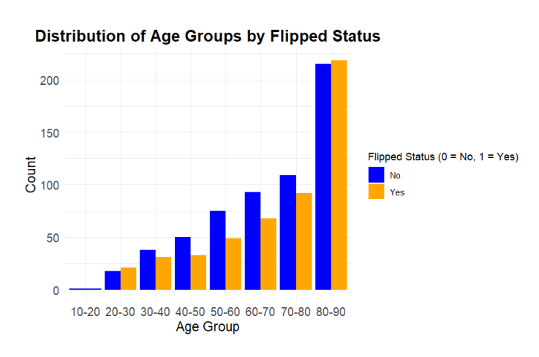
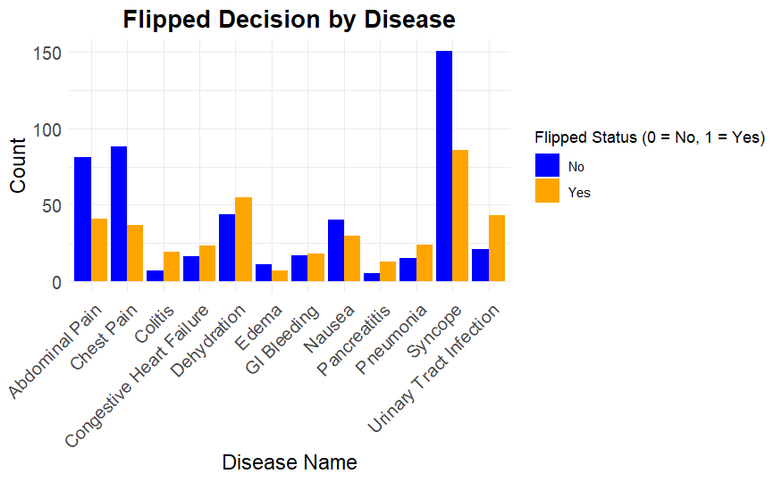
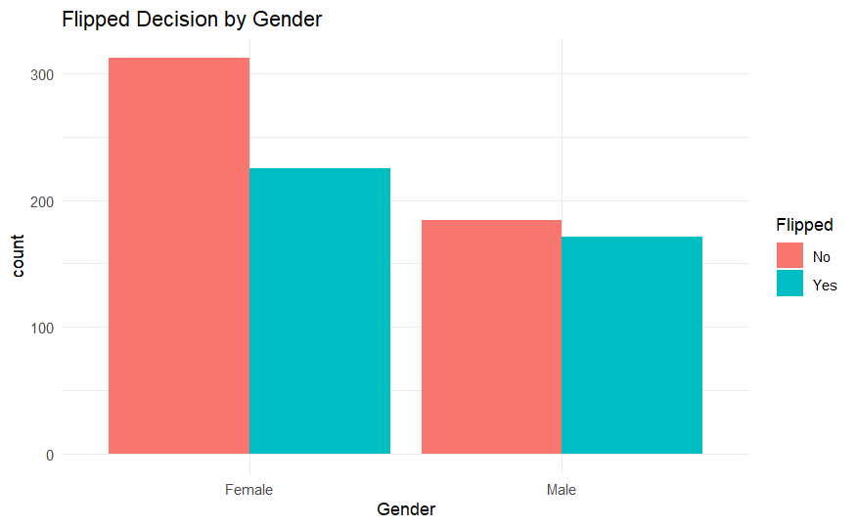
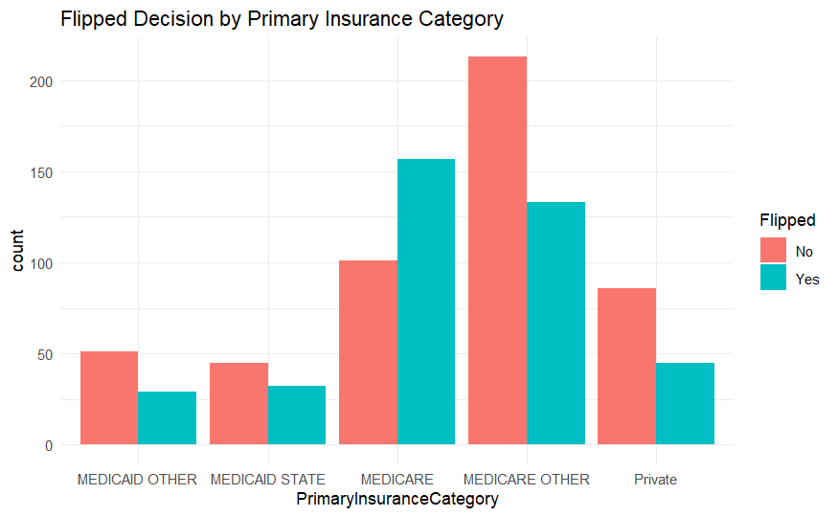
EDA / DATA VISUALISATION

Slide 7
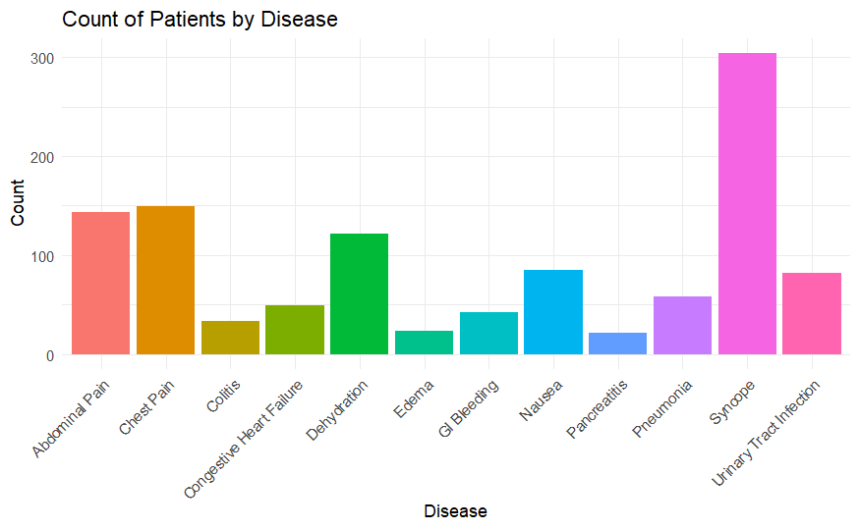
EDA / DATA VISUALISATION

Slide 8
Findings of EDA
CHART 1 – COUNT OF PATIENTS BY DISEASE
Syncope had the highest patient count, while colitis and edema had the lowest.
Chest pain and abdominal pain had similar high patient counts.
CHART 2 – DISTRIBUTION OF AGE GROUPS BY FLIPPED STATUS
Flipping is most common in the 70-90 age groups, especially in 80-90.
Younger age groups (10-50) show significantly fewer flipped cases.
CHART 3 – FLIPPED DECISION BY DISEASE
Syncope and dehydration had the highest flipped patient counts.
Abdominal pain and chest pain mostly resulted in non-flipped cases.
CHART 4 – FLIPPED DECISION BY GENDER
Females had more non-flipped cases compared to males.
Flipped status was almost equal between genders.
CHART 5 – FLIPPED DECISION BY PRIMARY INSURANCE CATEGORY
Medicare and Medicare Other had the highest non-flipped counts.
Medicaid Other and private insurance had more flipped cases.

Slide 9
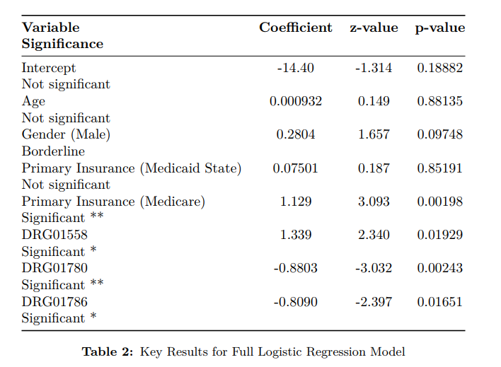
MODEL
Model Performance: • Null Deviance: 982.12 • Residual Deviance: 885.49 • AIC: 935.49
• Accuracy on Test Set: 65.36% • Sensitivity: 70.75% • Specificity: 57.53%
Interpretation: This logistic regression model suggests that certain variables, such as Medicare Insurance, DRG01558, DRG01780, and DRG01786, are statistically significant in predicting whether a patient will be flipped. The gender variable shows borderline significance.
Overall, the model provides reasonable predictive performance, with an accuracy of 65.36%
Full Logistic Regression Model - Model I

Slide 10
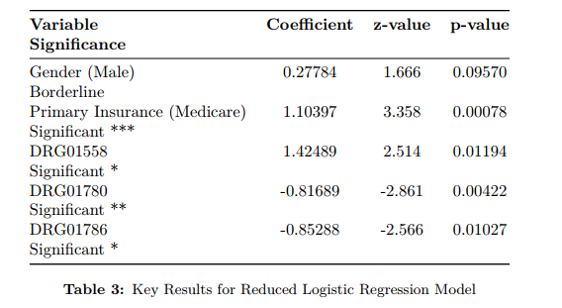
Reduced Logistic Regression Model
Model II
Model Performance: • Residual Deviance: 891.50 • AIC: 925.5
• Accuracy on Test Set: 61.45% • Sensitivity: 69.81% • Specificity: 49.32%
Interpretation: In this reduced model, Medicare Insurance, DRG01558, DRG01780, and DRG01786 remain significant predictors.
The model sacrifices some accuracy (61.45%) compared to the full model but provides a more concise and interpretable set of variables.

Slide 11
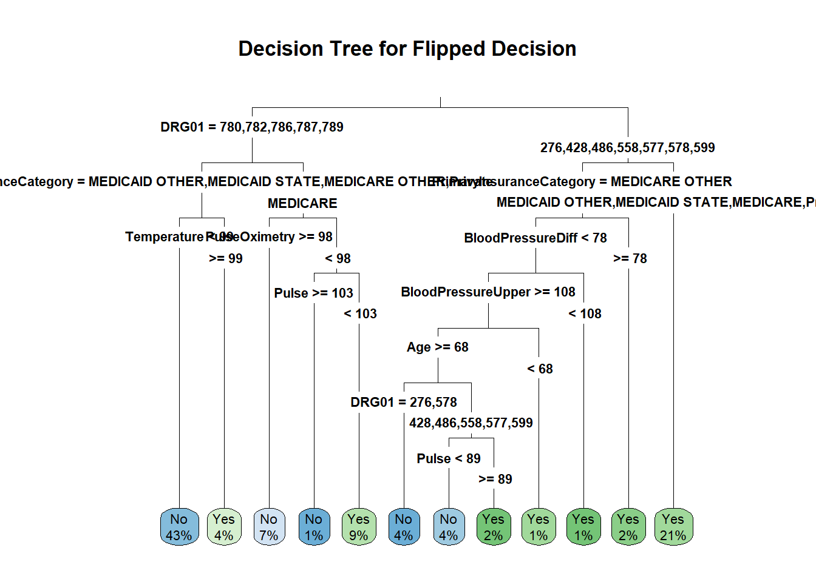
Decision Tree Model
Decision Tree Model – Model II
Decision Tree for Flipped Decision:
The decision tree shows that factors such as insurance category (e.g., Medicare, Medicaid), temperature, pulse, and blood pressure play significant roles in determining whether a patient will be "flipped" (transferred from observation to inpatient status).
For example, patients with higher temperatures (≥99) or pulse (≥103) tend to have a higher likelihood of being flipped, while those with lower pulse or certain DRG codes are less likely
Confusion Matrix Interpretation:
Accuracy: The model correctly predicted the flipped status 64.8% of the time.
Sensitivity (ability to predict 'No' correctly): 68.9%, meaning the model is fairly good at identifying non-flipped cases.
Specificity (ability to predict 'Yes' correctly): 58.9%, indicating room for improvement in identifying flipped cases.
Balanced Accuracy: 63.9%, showing the model's overall performance in balancing both classes.
In conclusion, while the model performs moderately well, with an accuracy of 64.8%, there is potential for improvement, especially in predicting flipped cases.

Slide 12
MODEL DEVELOPMENT
Random Forest – Model III
Random Forest Model:
Model Setup: A random forest classification model was created using 100 trees to predict the flipped status of patients based on gender, primary insurance category, and DRG01 codes.
Out-of-Bag (OOB) Error Rate: The OOB estimate of the error rate is 38.85%, meaning that approximately 39% of the predictions made on unseen data are expected to be incorrect.
Confusion Matrix Interpretation:
Accuracy: The model correctly predicted the flipped status 61.45% of the time, indicating moderate performance.
Sensitivity (ability to predict 'No' correctly): 70.75%, showing a good ability to identify non-flipped cases.
Specificity (ability to predict 'Yes' correctly): 47.95%, indicating the model struggles to accurately predict flipped cases.
Balanced Accuracy: 59.35%, which suggests the model has room for improvement, especially in identifying flipped cases.
Class Error: Non-flipped cases have a lower error rate (26.67%) compared to flipped cases (53.56%).
In conclusion, the random forest model shows moderate performance with an overall accuracy of 61.45%. While it performs reasonably well at predicting non-flipped cases, improvements could be made in identifying flipped cases.

Slide 13
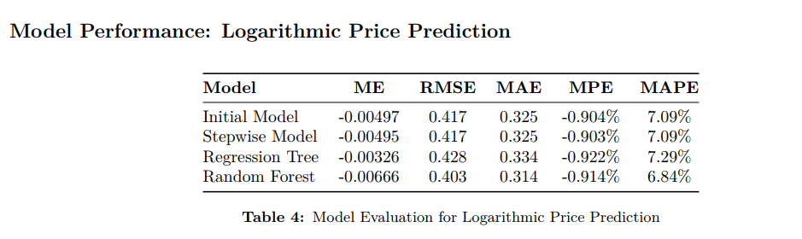
MODEL EVALUATION

Slide 14
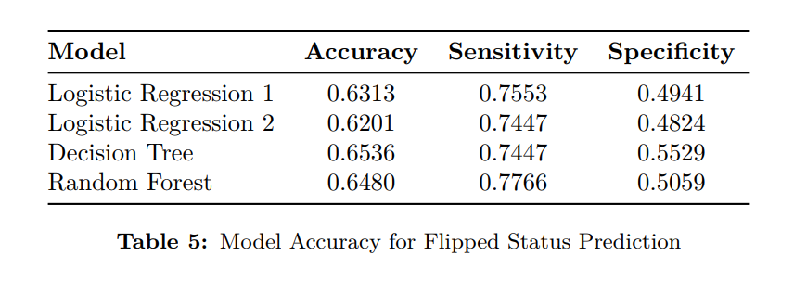
MODEL EVALUATION

Slide 15
FINAL MODEL SELECTION
Across all models, Medicare Insurance, specific DRG codes, and Gender (to a lesser extent) are consistently identified as important predictors of whether a patient will be flipped. The logistic regression model offers the best balance between interpretability and performance, making it the recommended choice for predicting flipping decisions.
However, the decision tree and random forest models offer alternative, more flexible approaches that could be further explored in future work.

Slide 16
Results

Slide 17

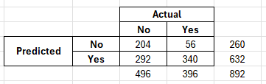

Final Model
Cutoff Point = 0.3
P(No Flipped) = 204/260 = 78%
P(Flipped) = 56/260 = 22%

Slide 18
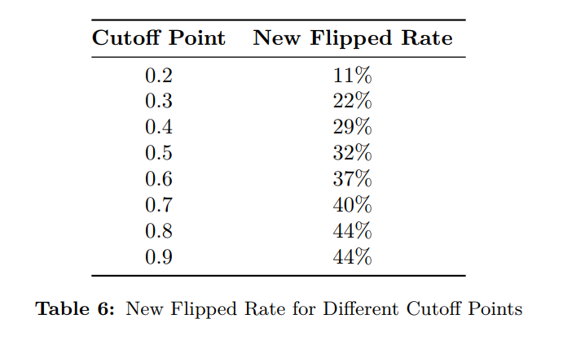
Cutoff Point & New Flipped Rates

Slide 19
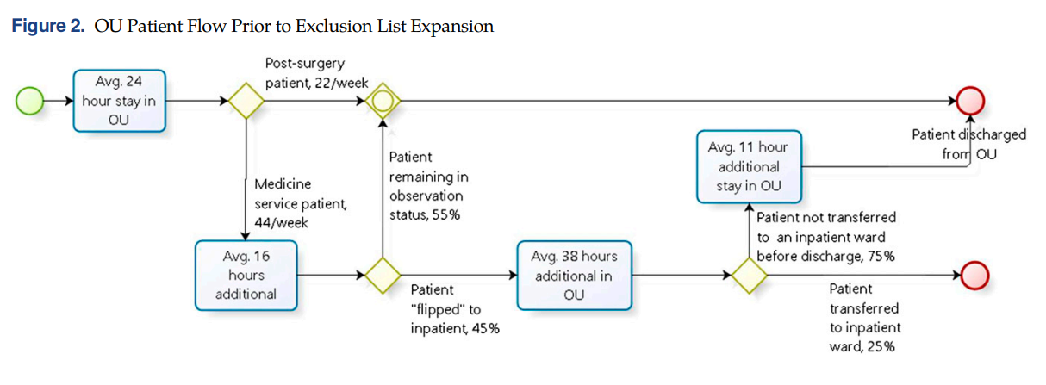

Based on the OU Patient Flow
Flipped Rate | Medicine service patients treated
45% | 44
30% | 49
20% | 55
Based on Dr.Kelly estimation

Slide 20
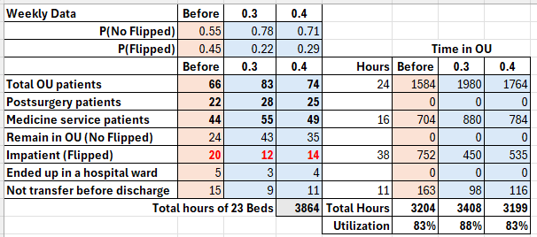
Calculated Total OU Patient
Current centers
Mars is actually a very cold place
Future centers
Venus is the second planet from the Sun

Slide 21

Annual reduction of 17 x 52weeks = 884 LWBS cases
Reduction in LWBS (Left Without Being Seen)

Slide 22
Monte Carlo Simulation
How increasing the number of patients affects OU utilization?
Flipped RANDOM with
Flipped Rate = 2.2
Simulated 100 runs with the number of patients increasing from 44 to 55

Slide 23
Conclusion
Increased weekly capacity: from 44 to 55 patients (570 additional patients/year).
Patient Flow Improvement: Lowered LWBS by 46%, with a potential revenue increase of $618,800/year.
Operational Efficiency: Bed utilization rose from 83% to 88% with a 22% flipped rate
Monte Carlo Simulation: Demonstrated the OU could handle increased patient load without sacrificing care quality.

Slide 24
Increased weekly capacity from 44 to 55 patients (570 additional patients/year).
Patient Flow Improvement: Lowered LWBS by 46%, preventing 884 patients from leaving annually, with a potential revenue increase of $618,800/year ($11,900/month).
Operational Efficiency: Bed utilization rose from 83% to 88% with a 22% flipped rate (cutoff 0.3), enhancing care without overburdening the unit.
Monte Carlo Simulation: Demonstrated the OU could handle increased patient load without sacrificing care quality.
Conclusion: Reducing the flipped rate improves efficiency, patient throughput, and revenue, offering a roadmap for operational enhancements.
Recommendation
Reducing the flipped rate improves efficiency, patient throughput, and revenue, offering a roadmap for operational enhancements.
Collecting more data to increase R square of Regression model which predict Length of Stay in the OU based and use its as a potential predictor for Flipped.
Using data to built more powerful “exclusion list” could decrease observation-level patients being admitted to inpatient beds.

Slide 25
Thanks

